Slide 1
Speech Translator with OCR reader

Slide 2
Made By :-
Nai Om Rajeshkumar (CE 072)
Parikh Vedant Jasminkumar (CE 080)

Slide 3
Abstract
Speech translator provides the flexibility to translate English language text to Gujarati language and vice versa.
Also, it provides the set of functionalities to give voice as an input and translate to the targeted language.
Thus, it provides a bridge among the people of two different dialects.
On addition to that this also have a feature of OCR – Reader which translate the English text to Gujrati just by providing the image as an input.

Slide 4
Introduction
Our main goal behind this project is to provide just a service which can serve day-to-day need of any person who is willing to communicate but cannot only because of the language problem. Also, tourist from the various country need to communicate with people with local dialect. So, for that purpose we provide “Speech Translator” helps people to communicate and get connect to them and it will help them to get translation of ENGLISH language into GUJARATI language and vice versa.
Also, in addition to that we have feature of OCR-Reader which just takes an image and translate the text into ENGLISH text to GUJARATI text which can also provide the flexibility of text reading.

Slide 5
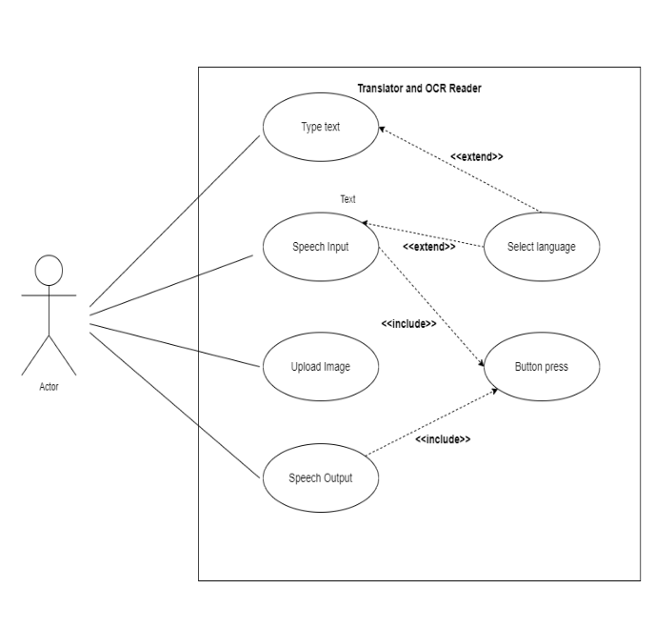
Use Case Diagram

Slide 6
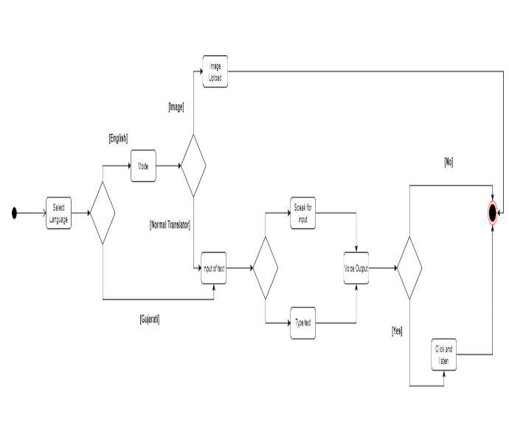
Activity diagram

Slide 7
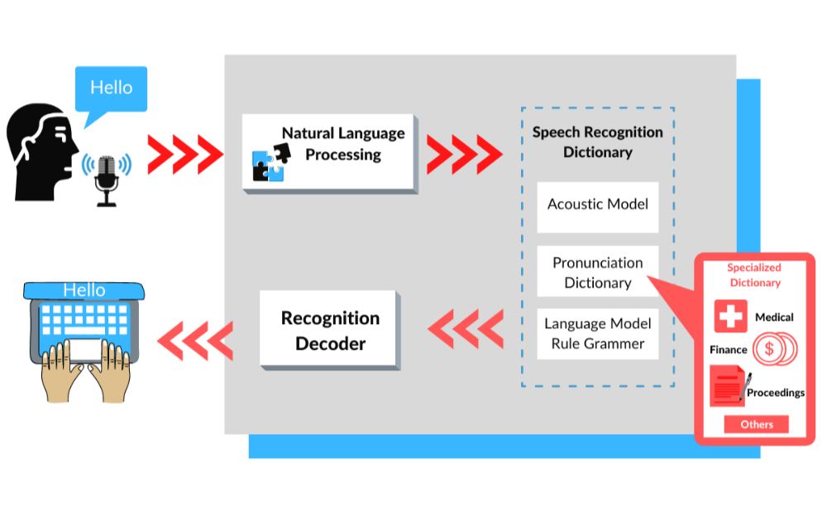
Stage 1 :- How speech to text works :-

Slide 8
Stage 1 :- How speech to text works :-
Analog To Digital Conversion : When human beings utter words and make sounds, it creates different sequences of vibrations. A speech-to-text model would specifically pick up these vibrations which are technically analog signals. An analog to digital converter then takes these vibrations as input to convert to a digital language.
Filtering : The sounds picked up and digitized by the analog to digital converter are in a form that is machine-consumable as an audio file. The converter analyses the audio file comprehensively and measures the waves in great detail. An underlying algorithm then classifies the relevant sounds and filters them to pick up those sounds that can eventually be transcribed.

Slide 9
Stage 1 :- How speech to text works :-
3) Segmentation : Segmentation is done on the basis of phonemes, which are linguistic devices that differentiate one word from another. This unit of sound is then compared against segmented words in the input audio for matching and predicting the possible transcriptions.
4) Character Integration : The speech-to-text software consists of a mathematical model consisting of various permutations and combinations of words, phrases, and sentences. The phonemes pass through a network consisting of elements of the mathematical model so that the most commonly occurring elements are compared to these phonemes. The likelihood of the probable textual output is calculated at this stage for integrating the segments into coherent phrases or segments.
5) Final Transcript : The audio's most likely transcript is presented as text at the end of this process based on deep learning predictive modeling. A computer-based demand generated from the above probabilities is then produced from the built-in dictation capabilities of the device that is being used for transcription.

Slide 10
Stage 1 :- How speech to text works :-
Commonly used algorithms :-
Convolutional Neural Networks (Gen. for images still can be used for audio input for extracting features)
Recurrent Neural Networks (temporal dependencies between frames)
Long Short-Term Memory (RNN only but handle longer range of data)
Transformer Networks (Early stage)
Impl :- LAS (Listen Attend Spell -> CNN + LSATM)

Slide 11
Stage 2 :- Translation Phase
Generally the procced data is feed to the RNN layer also comprise of the ENCODERS AND DECODERS layer which do work for the machine translation phase
Commonly used algorithms :-
RNNs
Encoders and Decoders

Slide 12
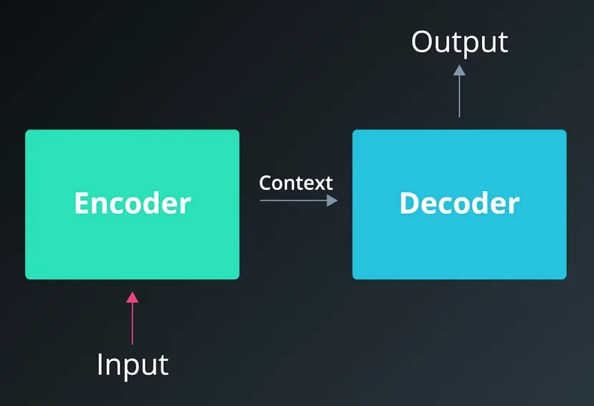
Stage 2 :- Translation Phase

Slide 13
Stage 2 :- Translation Phase
An encoder and decoder. The encoder summarizes the input into a context variable, also called the state. This context is then decoded and the output sequence is generated.
Since both the encoder and decoder are recurrent, they have loops which process each part of the sequence at different time steps.
At each time step, the encoder “reads” the input word and performs a transformation on its hidden state. Then it passes that hidden state to the next time step. Keep in mind that the hidden state represents the relevant context flowing through the network. The bigger the hidden state, the greater the learning capacity of the model, but also the greater the computation requirements.

Slide 14
Stage 2 :- Translation PHase
For now, notice that for each time step after the first word in the sequence there are two inputs: the hidden state and a word from the sequence. For the encoder, it’s the next word in the input sequence. For the decoder, it’s the previous word from the output sequence.
Also, remember that when we refer to a “word,” we really mean the vector representation of the word which comes from the embedding layer.
Here’s another way to visualize the encoder and decoder, except with a Mandarin input sequence.

Slide 15
Stage 2 :- Translation PHase

Slide 16
Stage 2 :- Translation phase
The encoder only has historical context. But, providing future context can result in better model performance. This may seem counterintuitive to the way humans process language since we only read in one direction.
However, humans often require future context to interpret what is being said. In other words, sometimes we don’t understand a sentence until an important word or phrase is provided at the end.
To implement this, we train two RNN layers simultaneously. The first layer is fed the input sequence as-is and the second is fed a reversed copy.

Slide 17
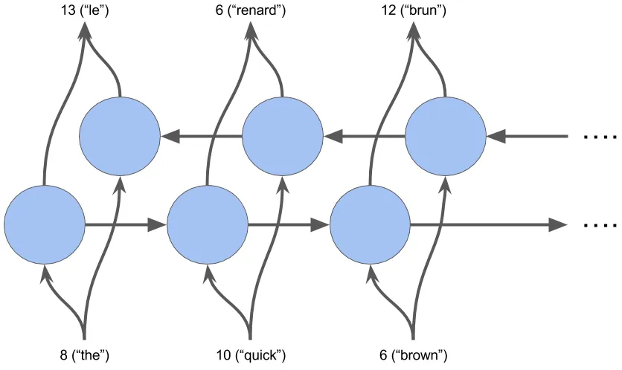
Stage 2 :- Translation phase

Slide 18
Stage 3: Conversion of Text image to text (OCR Reader part)
This is 4 stage process :-
Binarizing the image.
Noise removal from image.
Removing the border.
Extracting the text.

Slide 19
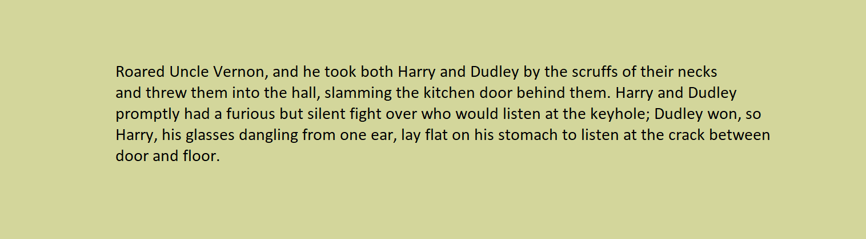
The above image is provided as an input.

Slide 20
Stage 3: Conversion of Text image to text (OCR Reader part)
1) Binarizing the image
It is the two step process.
Converting to grey scale
Converting to black and white.

Slide 21
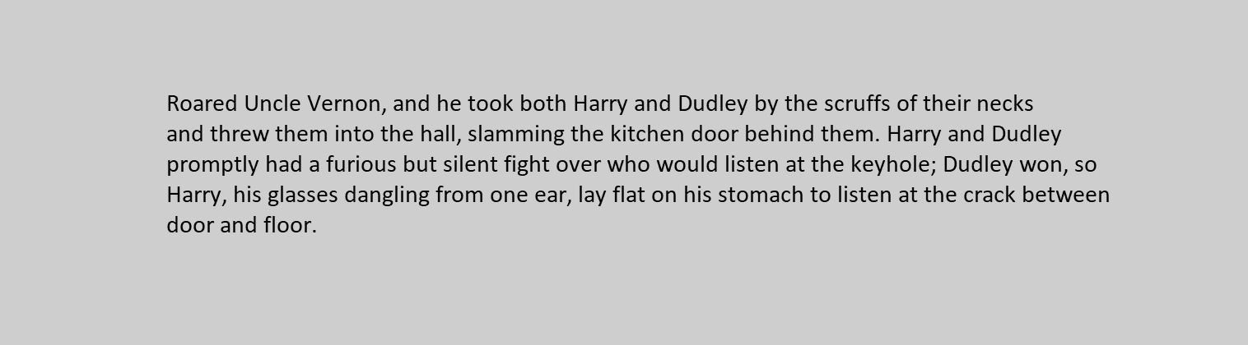
Stage 3: Conversion of Text image to text (OCR Reader part)
Converting to grey scale
Grayscale is a pre-processing layer that transforms RGB images to Grayscale images.
This is done because the grey scaled images are compressed to minimal pixels.
Binarizing the image

Slide 22
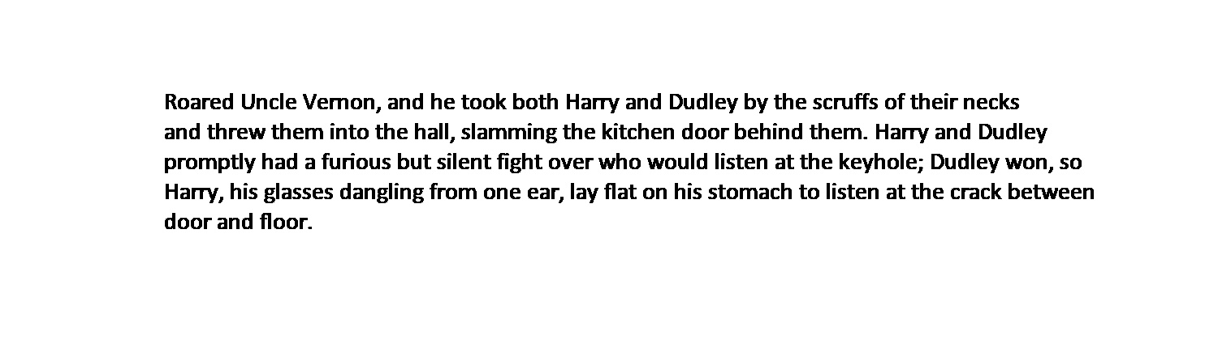
Stage 3: Conversion of Text image to text (OCR Reader part)
Converting to Black and White
This transformation is useful in detecting blobs and further reduces the computational complexity.
Threshold for every pixel is applied.
The function thresholds works on the following mathematical imputation, dst(x,y) = { (maxValue, if src(x,y)>thresh), (0, otherwise)}.
Binarizing the image

Slide 23
Stage 3: Conversion of Text image to text (OCR Reader part)
2) Noise removal from the image
This the important part of the image processing.
As if image contains some useless data because of some external factors and some generated due to internal pre-processing stage.
Kernal is set here for the certain pixel range to work upon.
It is 3 step process :-
Dilution Stage
Erosion Stage
Median Blur

Slide 24

Stage 3: Conversion of Text image to text (OCR Reader part)
Dilution Stage
It increases the thickness of the characters based on the morphological criteria provided the given kernel.
The erosion operation is: dst(x,y)=max(x′,y′):element(x′,y′)≠0src(x+x′,y+y′)
Noise removal from the image

Slide 25

Stage 3: Conversion of Text image to text (OCR Reader part)
Erosion Stage
It decreases the thickness of the characters based on the morphological criteria provided the given kernel
The erosion operation is: dst(x,y)=min(x′,y′):element(x′,y′)≠0src(x+x′,y+y′)
Noise removal from the image

Slide 26
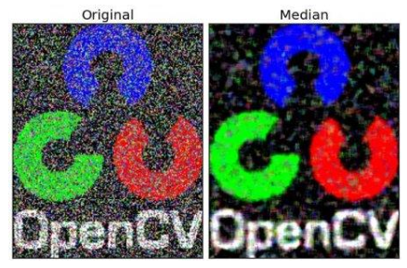
Stage 3: Conversion of Text image to text (OCR Reader part)
Median Blur
Blurring the image to the given scale.
Here, the input is passed and them the median of all the pixels under the kernel area and the central element is replaced with this median value. This is highly effective against salt-and-pepper noise in an image. Interestingly, in the above filters, the central element is a newly calculated value which may be a pixel value in the image or a new value. But in median blurring, the central element is always replaced by some pixel value in the image. It reduces the noise effectively.
Noise removal from the image

Slide 27
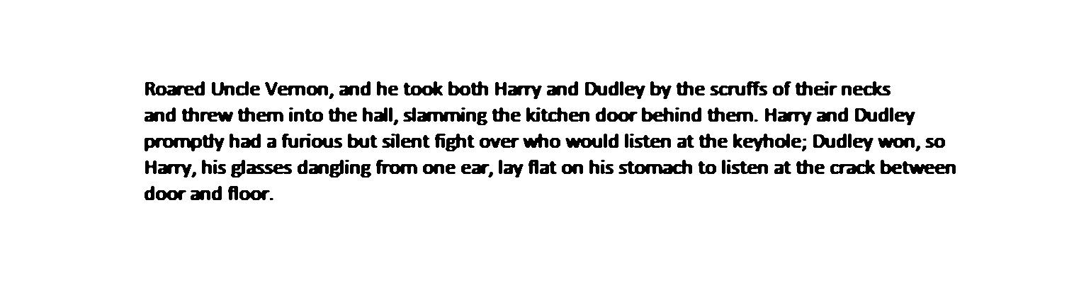
Stage 3: Conversion of Text image to text (OCR Reader part)
Final Output
Noise removal from the image

Slide 28
Stage 3: Conversion of Text image to text (OCR Reader part)
3) Remove borders from the image
Remove the image borders in order to allow more accurate OCR detection.
Noise removal from the image

Slide 29
Stage 4 : Extracting the Text (PyTesserect)
Now it is passed to PyTesseract module which does the job of text extraction.
In a nutshell, attention is a feed-forward layer with trainable weights that help us capture the relationships between different elements of sequences. It works by using query, key and value matrices, passing the input embeddings through a series of operations and getting an encoded representation of our original input sequence.

Slide 30
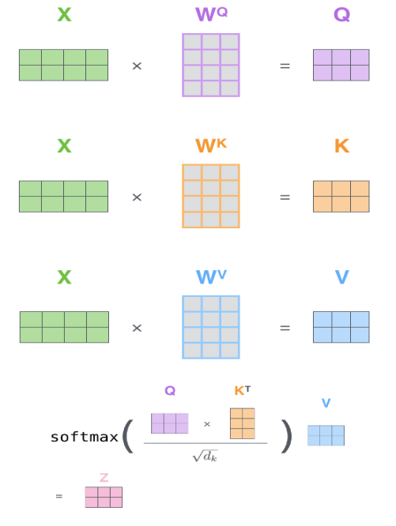
Stage 4 : Extracting the Text (PyTesserect)
A location RNN to predict the next glimpse location and another Classification RNN dedicated to predicting the class labels or guess which character is it we are looking at in the text. A context network is used to down sample image inputs for more generalizable RNN states. It also chooses to refer to the location network in RAM as Emission Network. The training is done using an accumulated reward and optimizing the sequence log-likelihood loss function using the REINFORCE policy gradient.

Slide 31
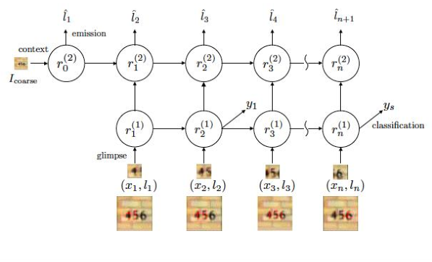
Stage 4 : Extracting the Text (PyTesserect)
CRNNs don't treat our OCR task as a reinforcement learning problem but as a machine learning problem with a custom loss. The loss used is called CTC loss – Connectionist Temporal Classification. The convolutional layers are used as feature extractors that pass these features to the recurrent layers - bi-directional LSTMs . These are followed by a transcription layer that uses a probabilistic approach to decode our LSTM outputs. Each frame generated by the LSTM is decoded into a character and these characters are fed into a final decoder/transcription layer which will output the final predicted sequence.

Slide 32
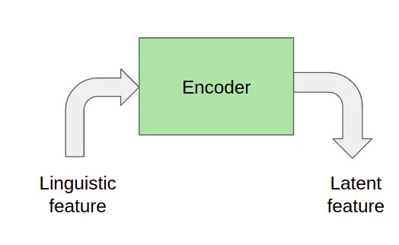
Stage 4 : Extracting the Text (PyTesserect)
The Linguistic feature only contains phonemes. Energy, pitch, and duration are actually used to train the energy predictor, the pitch predictor, and the duration predictor respectively which are used by the model to get a more natural output.

Slide 33
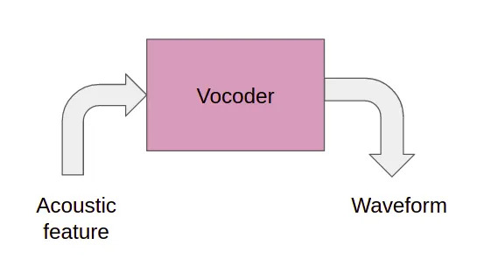
Stage 4 : Extracting the Text (PyTesserect)
It converts the Acoustic feature (Mel-spectrogram) to waveform output (audio). It can be done using a mathematical model like Griffin Lim or we can also train a neural network to learn the mapping from mel-spectrogram to waveforms. In reality, learning-based methods usually outperform the Griffin Lim method.

Slide 34
Refrences
Towards Data Science
Erosion and Dilution
PyTsseract
Project Link
Git Link For Project

